Slide 1

JAVA Training :
BASICS
Thomas DECOSTER
Java Senior Consultant
VPTT 2020 4.4.7.4 RC /
1

Slide 2
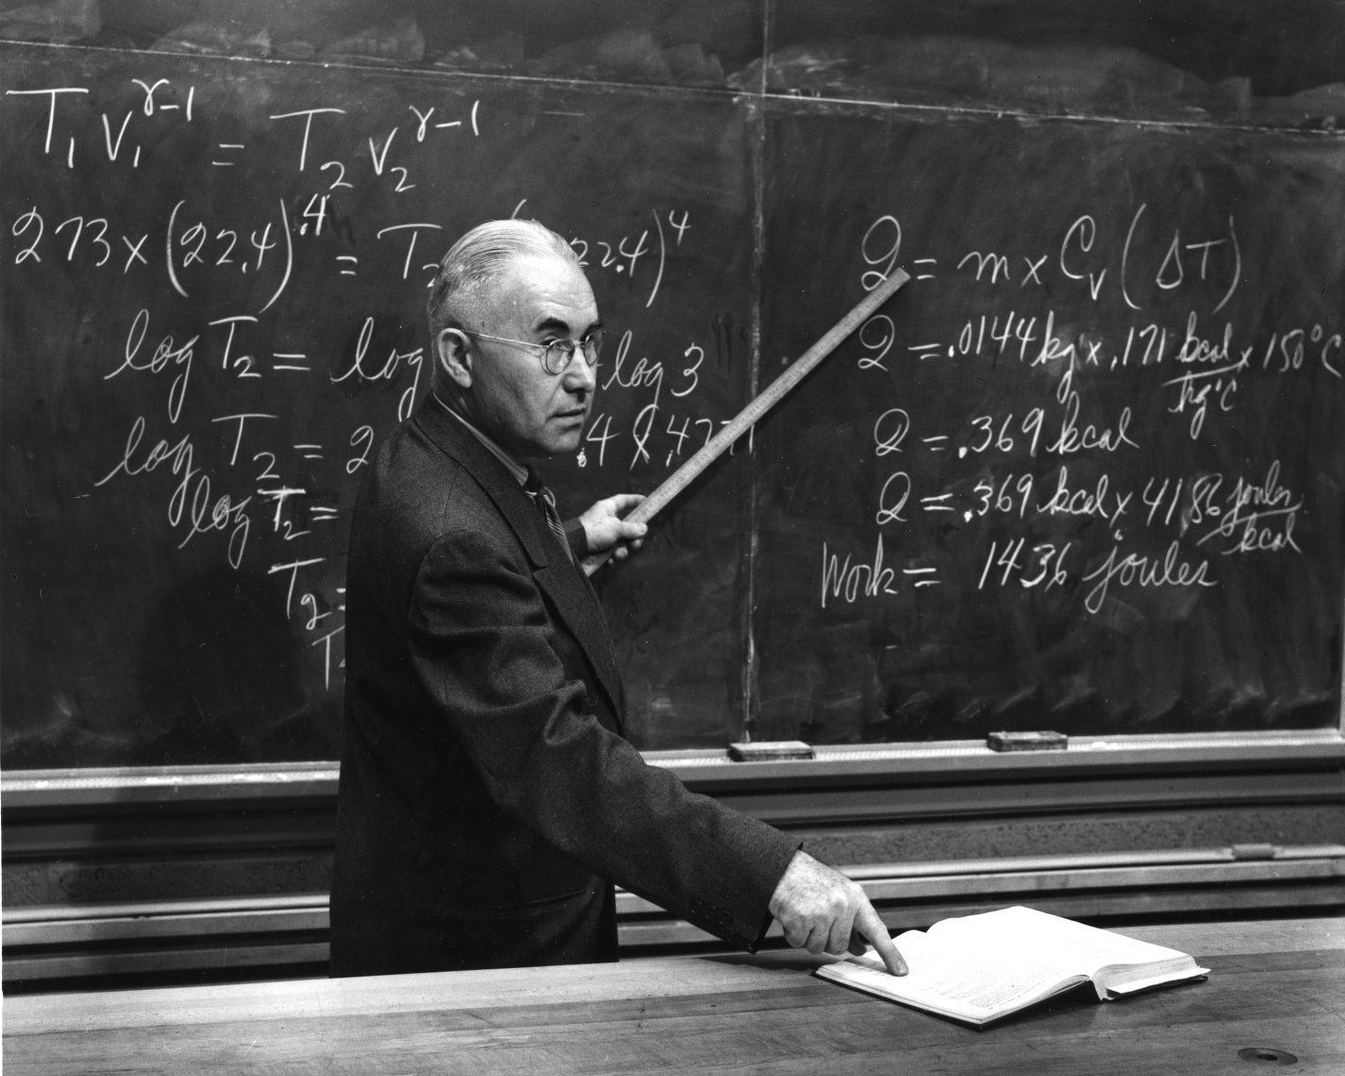

Agenda : Chapter 1
Introduction : Java Basics
JVM
Garbage Collector
JDK
Java Environment
IDE
Maven & co
GIT
VPTT 2020 4.4.7.4 RC /
2

Slide 3

Java Basics :
Java Virtual
Machine

Slide 4
Java is compiled AND interpreted
1. A class is defined in a “.java” file that bears its name
“Write once, run everywhere!”*
3. It is executed (or interpreted) by a JVM specific to each platform
1
Java source code
If it is an application
:
fichiers
*.
java
-
java
.
exe
(
Sun
)
Virtual Java
machine
(
Interpreter
)
Win
32
Virtual Java machine in the Web browser
2
Java compiler
Java bytecode
3
fichiers
*.
class
Virtual Java
machine
2. It is compiled in a “.class” bytecode file
(
Interpreter
)
Solaris
-
javac
.
exe
(
Sun
)

Slide 5
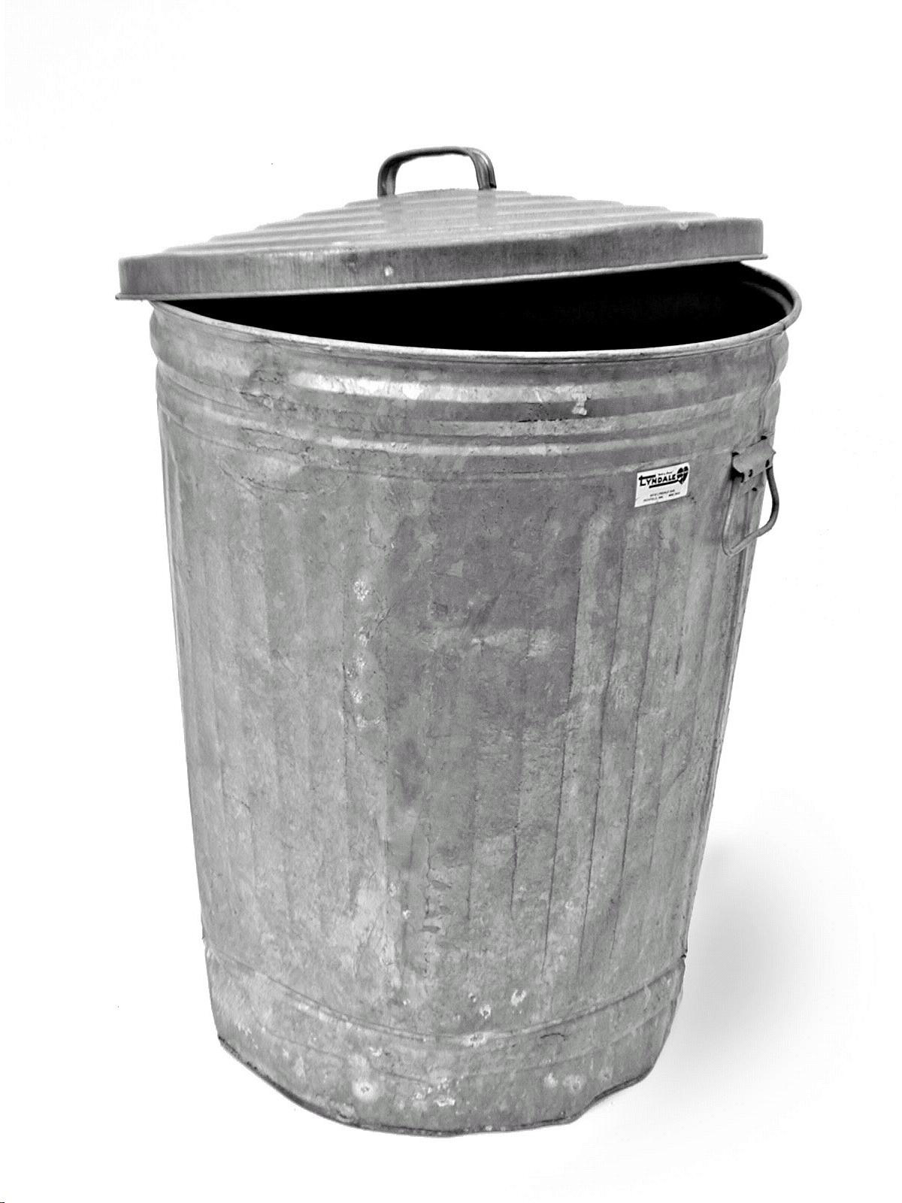
Java Basics :
Garbage Collector
JVM
JVM
JVM
1
2
4
1
2
4
1
2
7
5
7
5
3
3
3
6
6

Slide 6
Garbage Collector.
The Garbage Collector is a robot
Do not play with the GC :
- Do not use System.gc()
- Do not use the method finalize()
Use -Xms / -Xmx to manage memory usage
VPTT 2020 4.4.7.4 RC /
6

Slide 7

Java Basics :
Java Environment

Slide 8
JDK.
Includes compiler & runtime environement
this is true for all your
dev environement tools
Multiple Implementations
Choose the same version as your projets uses
Make sure everyone in the team and every environment has the same Java version as the prodution target Java
https://www.oracle.com/fr/java/technologies/javase-downloads.html
https://adoptopenjdk.net/
VPTT 2020 4.4.7.4 RC /
8

Slide 9


IDE.
for our training
we will use Intellij
Intellij or Eclipse
VPTT 2020 4.4.7.4 RC /
9

Slide 10


Build
& dependency management
for our training
we will use Maven
Maven or Gradle
VPTT 2020 4.4.7.4 RC /
10

Slide 11

Application Server.
for our training
we will use Tomcat
Other implementations include : Glassfish, Weblogic, Websphere, JBoss, Jetty
Some can be embeded with Spring boot : Tomcat, Jetty and Undertow
VPTT 2020 4.4.7.4 RC /
11

Slide 12

Continuous Integration.
Automated test execution
Automated builds
Automated deployment
VPTT 2020 4.4.7.4 RC /
12

Slide 13

Artifact Repository.
VPTT 2020 4.4.7.4 RC /
13

Slide 14

Continuous Inspection
& Code Quality.
VPTT 2020 4.4.7.4 RC /
14

Slide 15
Run a java program.
# check java version
java -version
# run with .class file
java com.valtech.vitp.HelloValtech arg1 agr2
# run with .jar file
java -jar target/run-java-program-1.0-SNAPSHOT.jar arg1 arg2
VPTT 2020 4.4.7.4 RC /
15

Slide 16
Run a java program.
Run as a web application in a web application server
Run as a standalone web application
Run as a service (with a wrapper for windows)
VPTT 2020 4.4.7.4 RC /
16

Slide 17
Maven.
pom.xml
modules and multi-modules projects
Dependencies
project structure
Commands
build steps
Plugins
settings.xml
VPTT 2020 4.4.7.4 RC /
17

Slide 18
Maven : pom.xml
<?xml version="1.0" encoding="UTF-8"?> <project xmlns="http://maven.apache.org/POM/4.0.0" xmlns:xsi="http://www.w3.org/2001/XMLSchema-instance" xsi:schemaLocation="http://maven.apache.org/POM/4.0.0 http://maven.apache.org/xsd/maven-4.0.0.xsd"> <parent> <artifactId>javatraining</artifactId> <groupId>com.valtech.vitp</groupId> <version>1.0-SNAPSHOT</version> </parent> <modelVersion>4.0.0</modelVersion> <artifactId>run-java-program</artifactId> <packaging>jar</packaging>
<properties> <mockito-core.version>2.28.2</mockito-core.version> <junit.version>4.12</junit.version> </properties>
<dependencies> <dependency> <groupId>junit</groupId> <artifactId>junit</artifactId> <version>${junit.version}</version> <scope>test</scope> </dependency> <dependency> <groupId>org.mockito</groupId> <artifactId>mockito-core</artifactId> <version>${mockito-core.version}</version> <scope>test</scope> </dependency> </dependencies> </project>
VPTT 2020 4.4.7.4 RC /
18

Slide 19
Maven : modules
<?xml version="1.0" encoding="UTF-8"?> <project xmlns="http://maven.apache.org/POM/4.0.0" xmlns:xsi="http://www.w3.org/2001/XMLSchema-instance" xsi:schemaLocation="http://maven.apache.org/POM/4.0.0 http://maven.apache.org/xsd/maven-4.0.0.xsd"> <modelVersion>4.0.0</modelVersion> <groupId>com.valtech.vitp</groupId> <artifactId>javatraining</artifactId> <version>1.0-SNAPSHOT</version> <packaging>pom</packaging> <modules> <module>chapter1-run-java-program</module> <module>chapter2-basic-syntax</module> <module>chapter3-test-driven-developement</module> <module>chapter4-web</module> <module>chapter5-advanced</module> <module>chapter6-libraries</module> </modules> <build> <plugins> <plugin> <groupId>org.apache.maven.plugins</groupId> <artifactId>maven-compiler-plugin</artifactId> <version>3.8.0</version> <configuration> <release>11</release> </configuration> </plugin> </plugins> </build> </project>
VPTT 2020 4.4.7.4 RC /
19

Slide 20
Maven : dependencies
<dependencies> <dependency> <groupId>org.springframework.boot</groupId> <artifactId>spring-boot-dependencies</artifactId> <version>2.4.3</version> <type>pom</type> <scope>import</scope> </dependency> <dependency> <groupId>org.apache.commons</groupId> <artifactId>commons-lang3</artifactId> <version>3.12.0</version> </dependency> <dependency> <groupId>javax.servlet</groupId> <artifactId>servlet-api</artifactId> <version>2.5</version> <scope>provided</scope> </dependency> <dependency> <groupId>junit</groupId> <artifactId>junit</artifactId> <version>${junit.version}</version> <scope>test</scope> </dependency> <dependency> <groupId>org.mockito</groupId> <artifactId>mockito-core</artifactId> <version>${mockito-core.version}</version> <scope>test</scope> </dependency> </dependencies>
VPTT 2020 4.4.7.4 RC /
20

Slide 21
Maven : directory structure
└───maven-project
├───pom.xml
├───src
│ ├───main
│ │ ├───java
│ │ ├───resources
│ │ │ └───META-INF
│ │ └───webapp
│ │ └───WEB-INF
│ │ └───web.xml
│ ├───test
│ │ ├───java
│ │ └───resources
│ ├───it
│ ├───site
│ └───assembly
└───target
├───classes
├───test-classes
├───test-reports
├───generated-sources
├───maven-project-1.0-SNAPSHOT.jar
└───maven-project-1.0-SNAPSHOT.war
VPTT 2020 4.4.7.4 RC /
21

Slide 22
Maven : build phases
phase(s) | operations
validate | checks all pom.xml
initialize | initialize properties and directories
generate-sources + process-sources | if needed prepares source code
compile | compile the source code of the project
generate-test-sources + process-test-sources + generate-test-resources + process-test-resources + test-compile | same operations for test directory
test | run tests
package | prepares the final artifact (jar or war)
integration-test +verify | runs integration tests
install | put the package into the local repository
deploy | put the package in a distant shared repository for publishing
VPTT 2020 4.4.7.4 RC /
22

Slide 23
Maven : commands
// the command used all day long
mvn clean install
// sometimes you don’t want to run unit tests...
mvn clean install -DskipTests
// to run integration tests
mvn clean verify
// deploy on the shared repo (most of the time run by jenkins)
mvn clean deploy
// useful to resolve dependency problems
mvn dependency:tree -Dverbose -Dincludes=commons-collections
VPTT 2020 4.4.7.4 RC /
23

Slide 24
Maven : plugins
<plugin> <groupId>com.sun.xml.ws</groupId> <artifactId>jaxws-maven-plugin</artifactId> <version>2.3.2</version> <executions> <execution> <id>generate-java-sources</id> <phase>process-sources</phase> <goals> <goal>wsimport</goal> </goals> <configuration> <extension>true</extension> <wsdlLocation>https://www.w3schools.com/xml/tempconvert.asmx?WSDL</wsdlLocation> <wsdlLocation>/wsdl/MyService.wsdl</wsdlLocation> </configuration> </execution> </executions> <dependencies> <dependency> <groupId>javax.xml.bind</groupId> <artifactId>jaxb-api</artifactId> <version>2.3.1</version> </dependency> <dependency> <groupId>javax.xml.ws</groupId> <artifactId>jaxws-api</artifactId> <version>2.3.1</version> </dependency> </dependencies> </plugin>
VPTT 2020 4.4.7.4 RC /
24

Slide 25
Maven : settings.xml
<settings>
...
<localRepository>${user.home}/.m2/repository</localRepository>
...
<mirrors>
<mirror>
<id>internal-repository</id>
<name>Maven Repository Manager running on repo.mycompany.com</name>
<url>http://repo.mycompany.com/proxy</url>
<mirrorOf>*</mirrorOf>
</mirror>
</mirrors>
...
<proxies>
<proxy>
<id>example-proxy</id>
<active>true</active>
<protocol>http</protocol>
<host>proxy.example.com</host>
<port>8080</port>
<username>proxyuser</username>
<password>somepassword</password>
<nonProxyHosts>www.google.com|*.example.com</nonProxyHosts>
</proxy>
</proxies>
...
</settings>
VPTT 2020 4.4.7.4 RC /
25

Slide 26
GIT Workflow.
Find the right branch
git pull --rebase
git branch -a
not found
Create a new remote branch
git checkout -b branch_name
git push -u origin/branch_name
found
Checkout branch
git checkout --track -b branch_name origin/branch_name
Work
git add -A
git commit -m”message”
Check locally
git pull --rebase
mvn clean install
Push
git push
VPTT 2020 4.4.7.4 RC /
26

Slide 27






GIT Workflow.
Check Jenkins build is OK
Use your eyes
Create a pull request
Someone else validates your pull request
Merge in master
git checkout target_branch_name
git merge branch_name
git push
Back in master
git checkout master
Go back to first step !
VPTT 2020 4.4.7.4 RC /
27

Slide 28
GIT - Useful aliases.
Add those aliases and functions to your ~/.bash-profile :
## maven ##
alias mci='mvn clean install'
alias mcist='mvn clean install -DskipTests'
## git ##
alias gpr='git pull --rebase'
alias gs='git status'
alias gaa='git add -A'
alias gk='gitk --all&'
alias gp='git push'
alias gba='git branch -a'
# new remote branch
function gnrb {
if [ "$#" -ne 1 ]; then
echo "Usage : gnrb branch_name"
else
git checkout -b $1
git push -u origin/$1
fi
}
# checkout remote branch
function grco {
if [ "$#" -ne 1 ]; then
echo "Usage : grco branch_name"
else
git checkout --track -b $1 origin/$1
fi
}
VPTT 2020 4.4.7.4 RC /
28

Slide 29

Thank You
Thomas Decoster, Java Senior Consultant
thomas.decoster@valtech.com
VPTT 2020 4.4.7.4 RC /
29

Slide 30
VPTT 2020 4.4.7.4 RC /
30
Notes:
30

